Slide 1
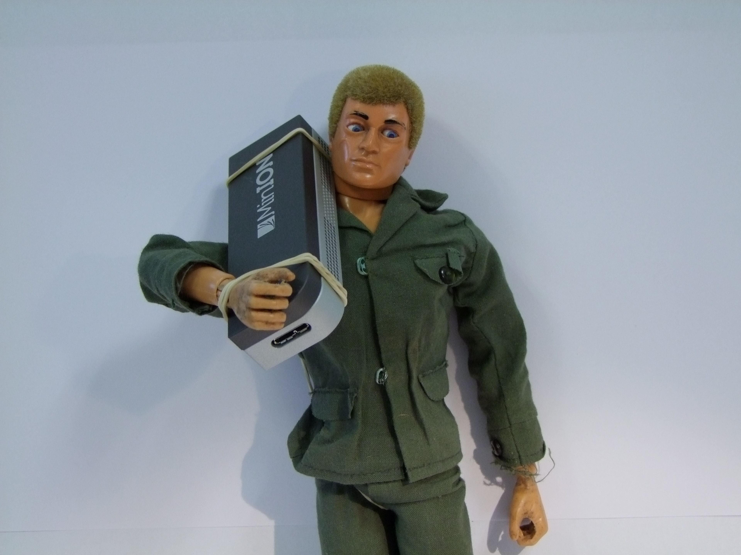
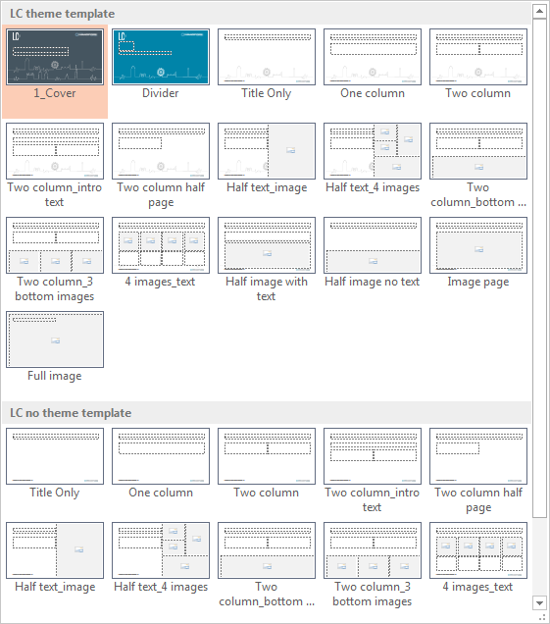
Sequencers for soldiers: battlefield genomics
REAPPLYING THE SLIDE LAYOUT
Putting text into a placeholder not only ensures the text sits in the correct place and is formatted correctly, it also helps to update the page quickly and efficiently.
Right click on any part of slide
Click on ‘Layout’
Select the layout you require
Claire Lonsdale, Dstl
26th May 2016

Slide 2

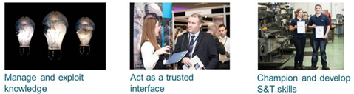
What is Dstl?

Slide 3

Across government

Slide 4

Working with academia

Slide 5









Working with industry

Slide 6
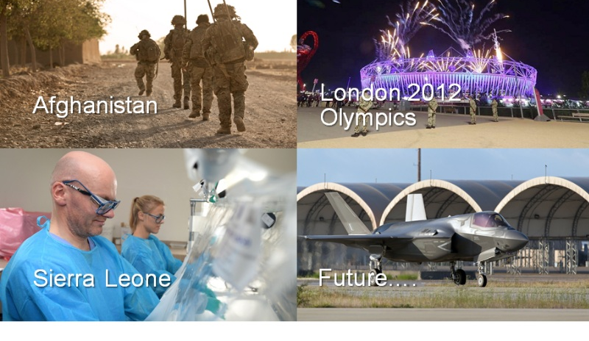

Slide 7
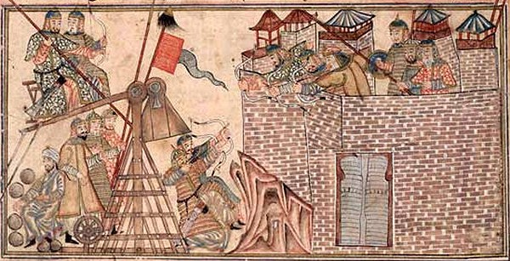
Why does defence and security care about sequencing?

Slide 8
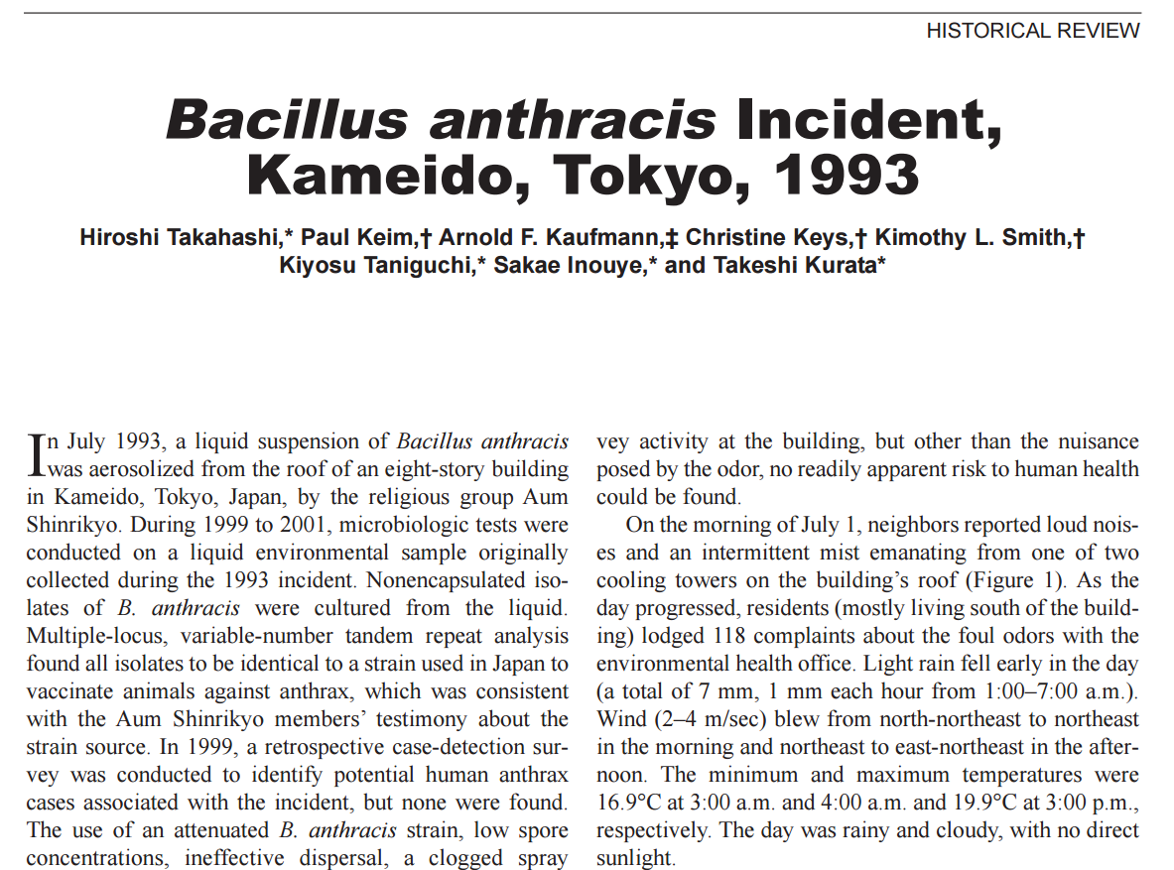
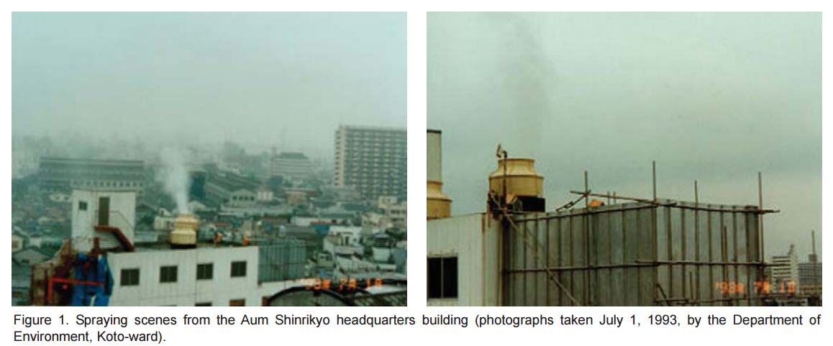
Emerging Infectious Diseases Vol. 10, No. 1, January 2004

Slide 9
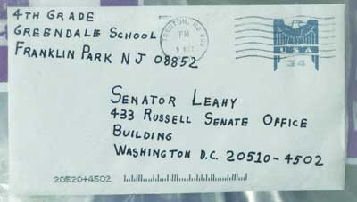
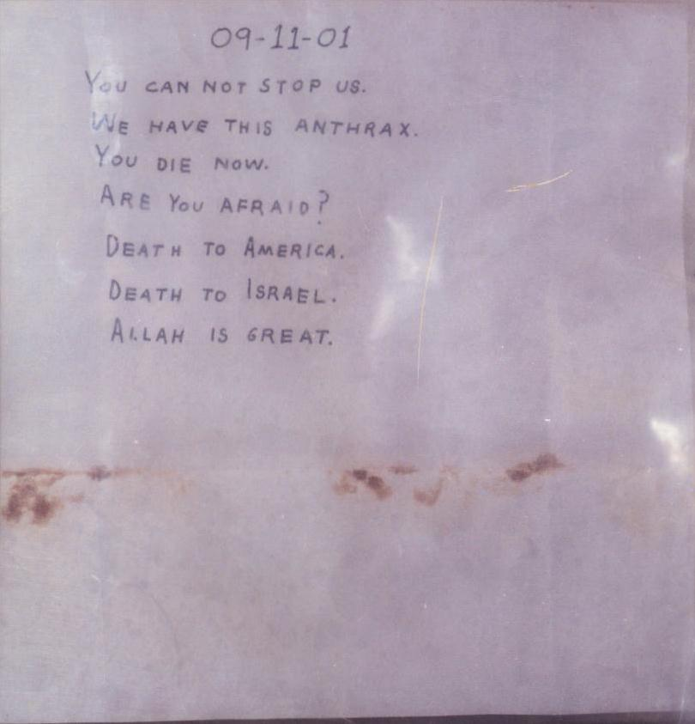
‘Amerithrax’ Letters, 2001
Letters laced with Bacillus anthracis
5 fatalities,
17 confirmed infections,
1000s treated
Crown copyright (2016), Dstl

Slide 10

UK, 2014
Convicted of buying and attempting to buy abrin on the internet
First UK prosecution under Biological Weapons Act
Dstl scientists gave evidence at the trial

Slide 11
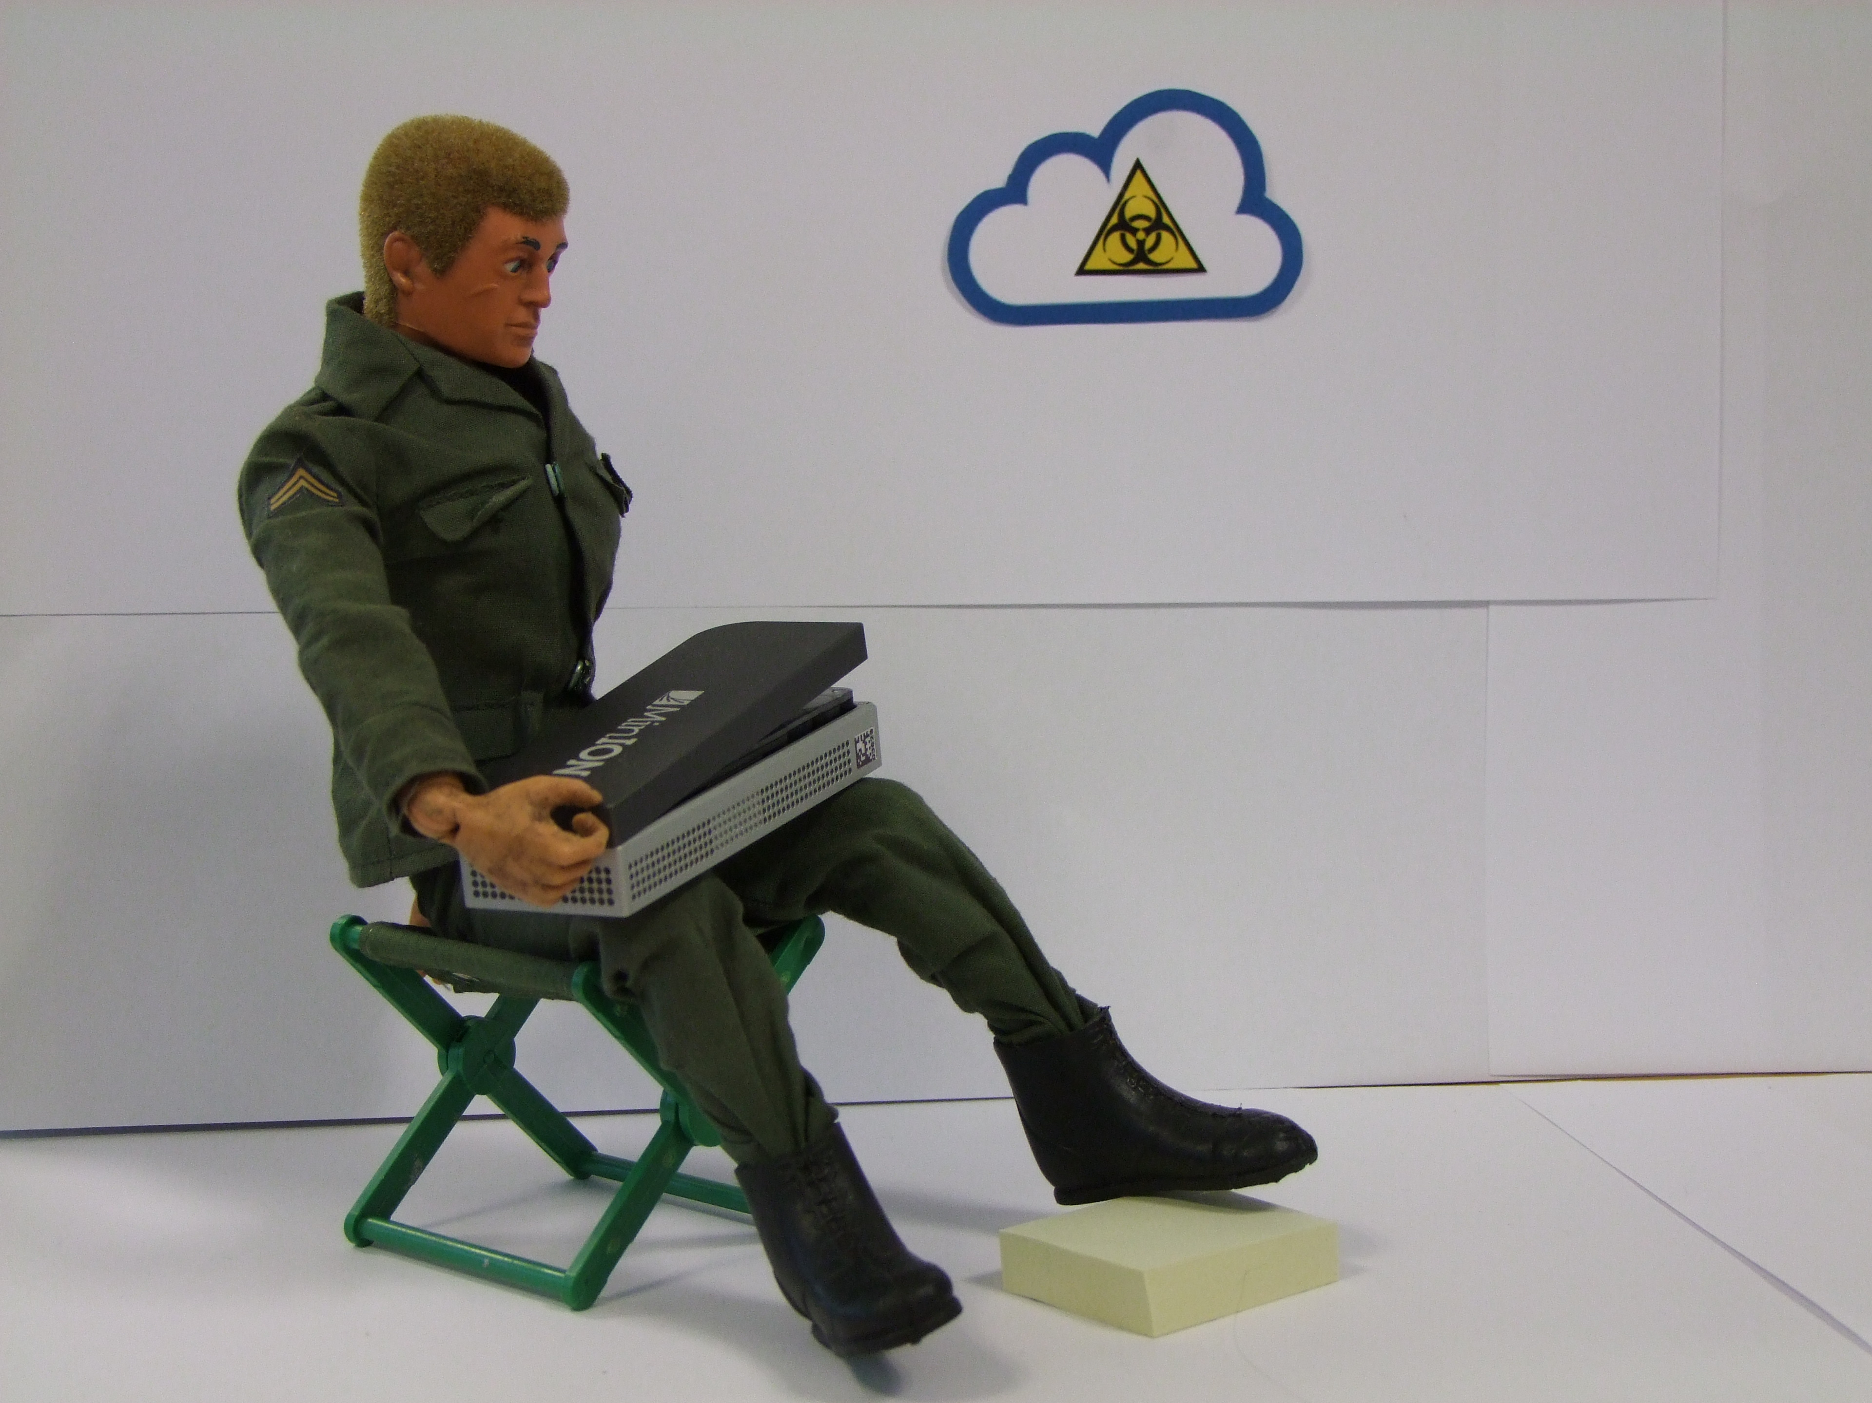
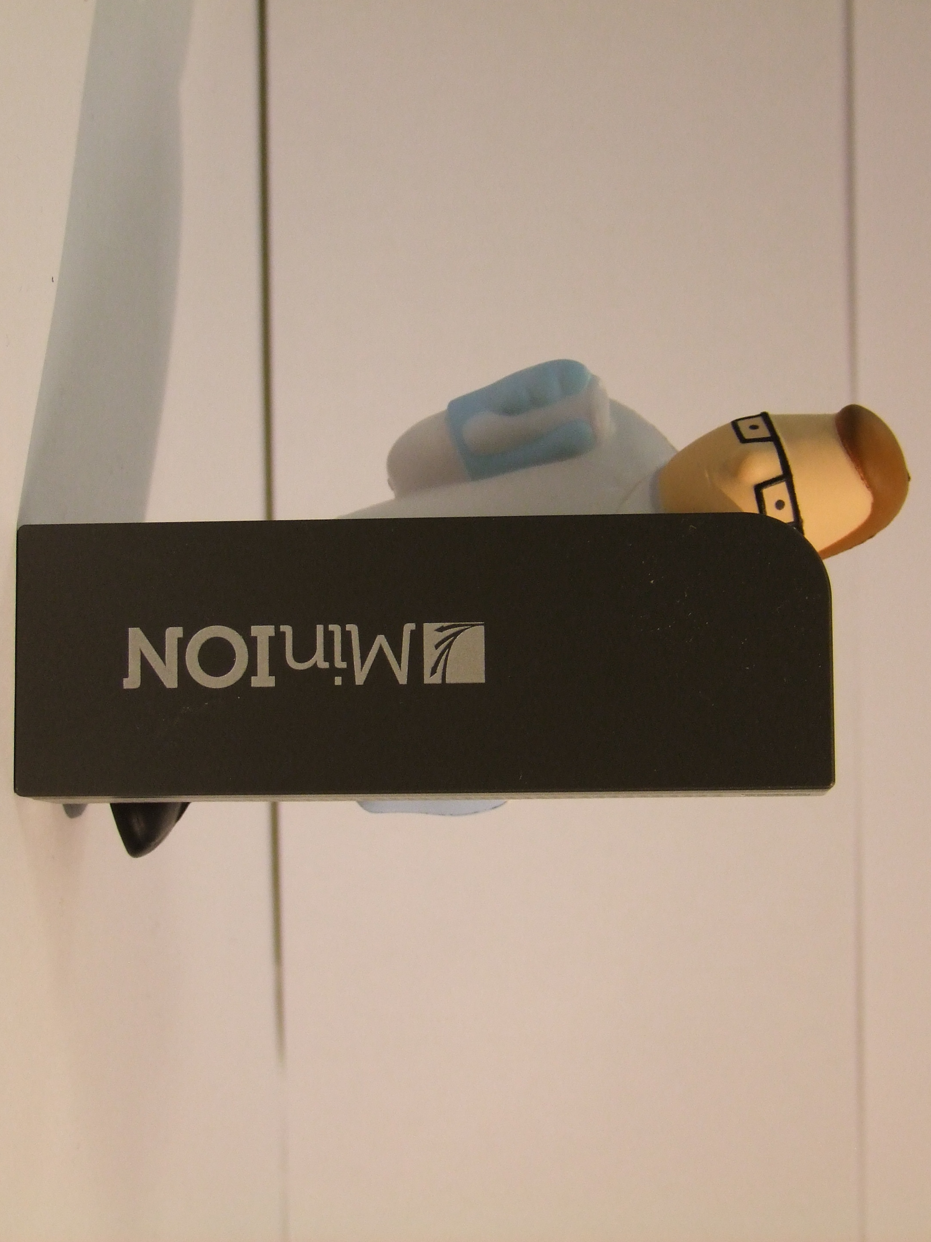
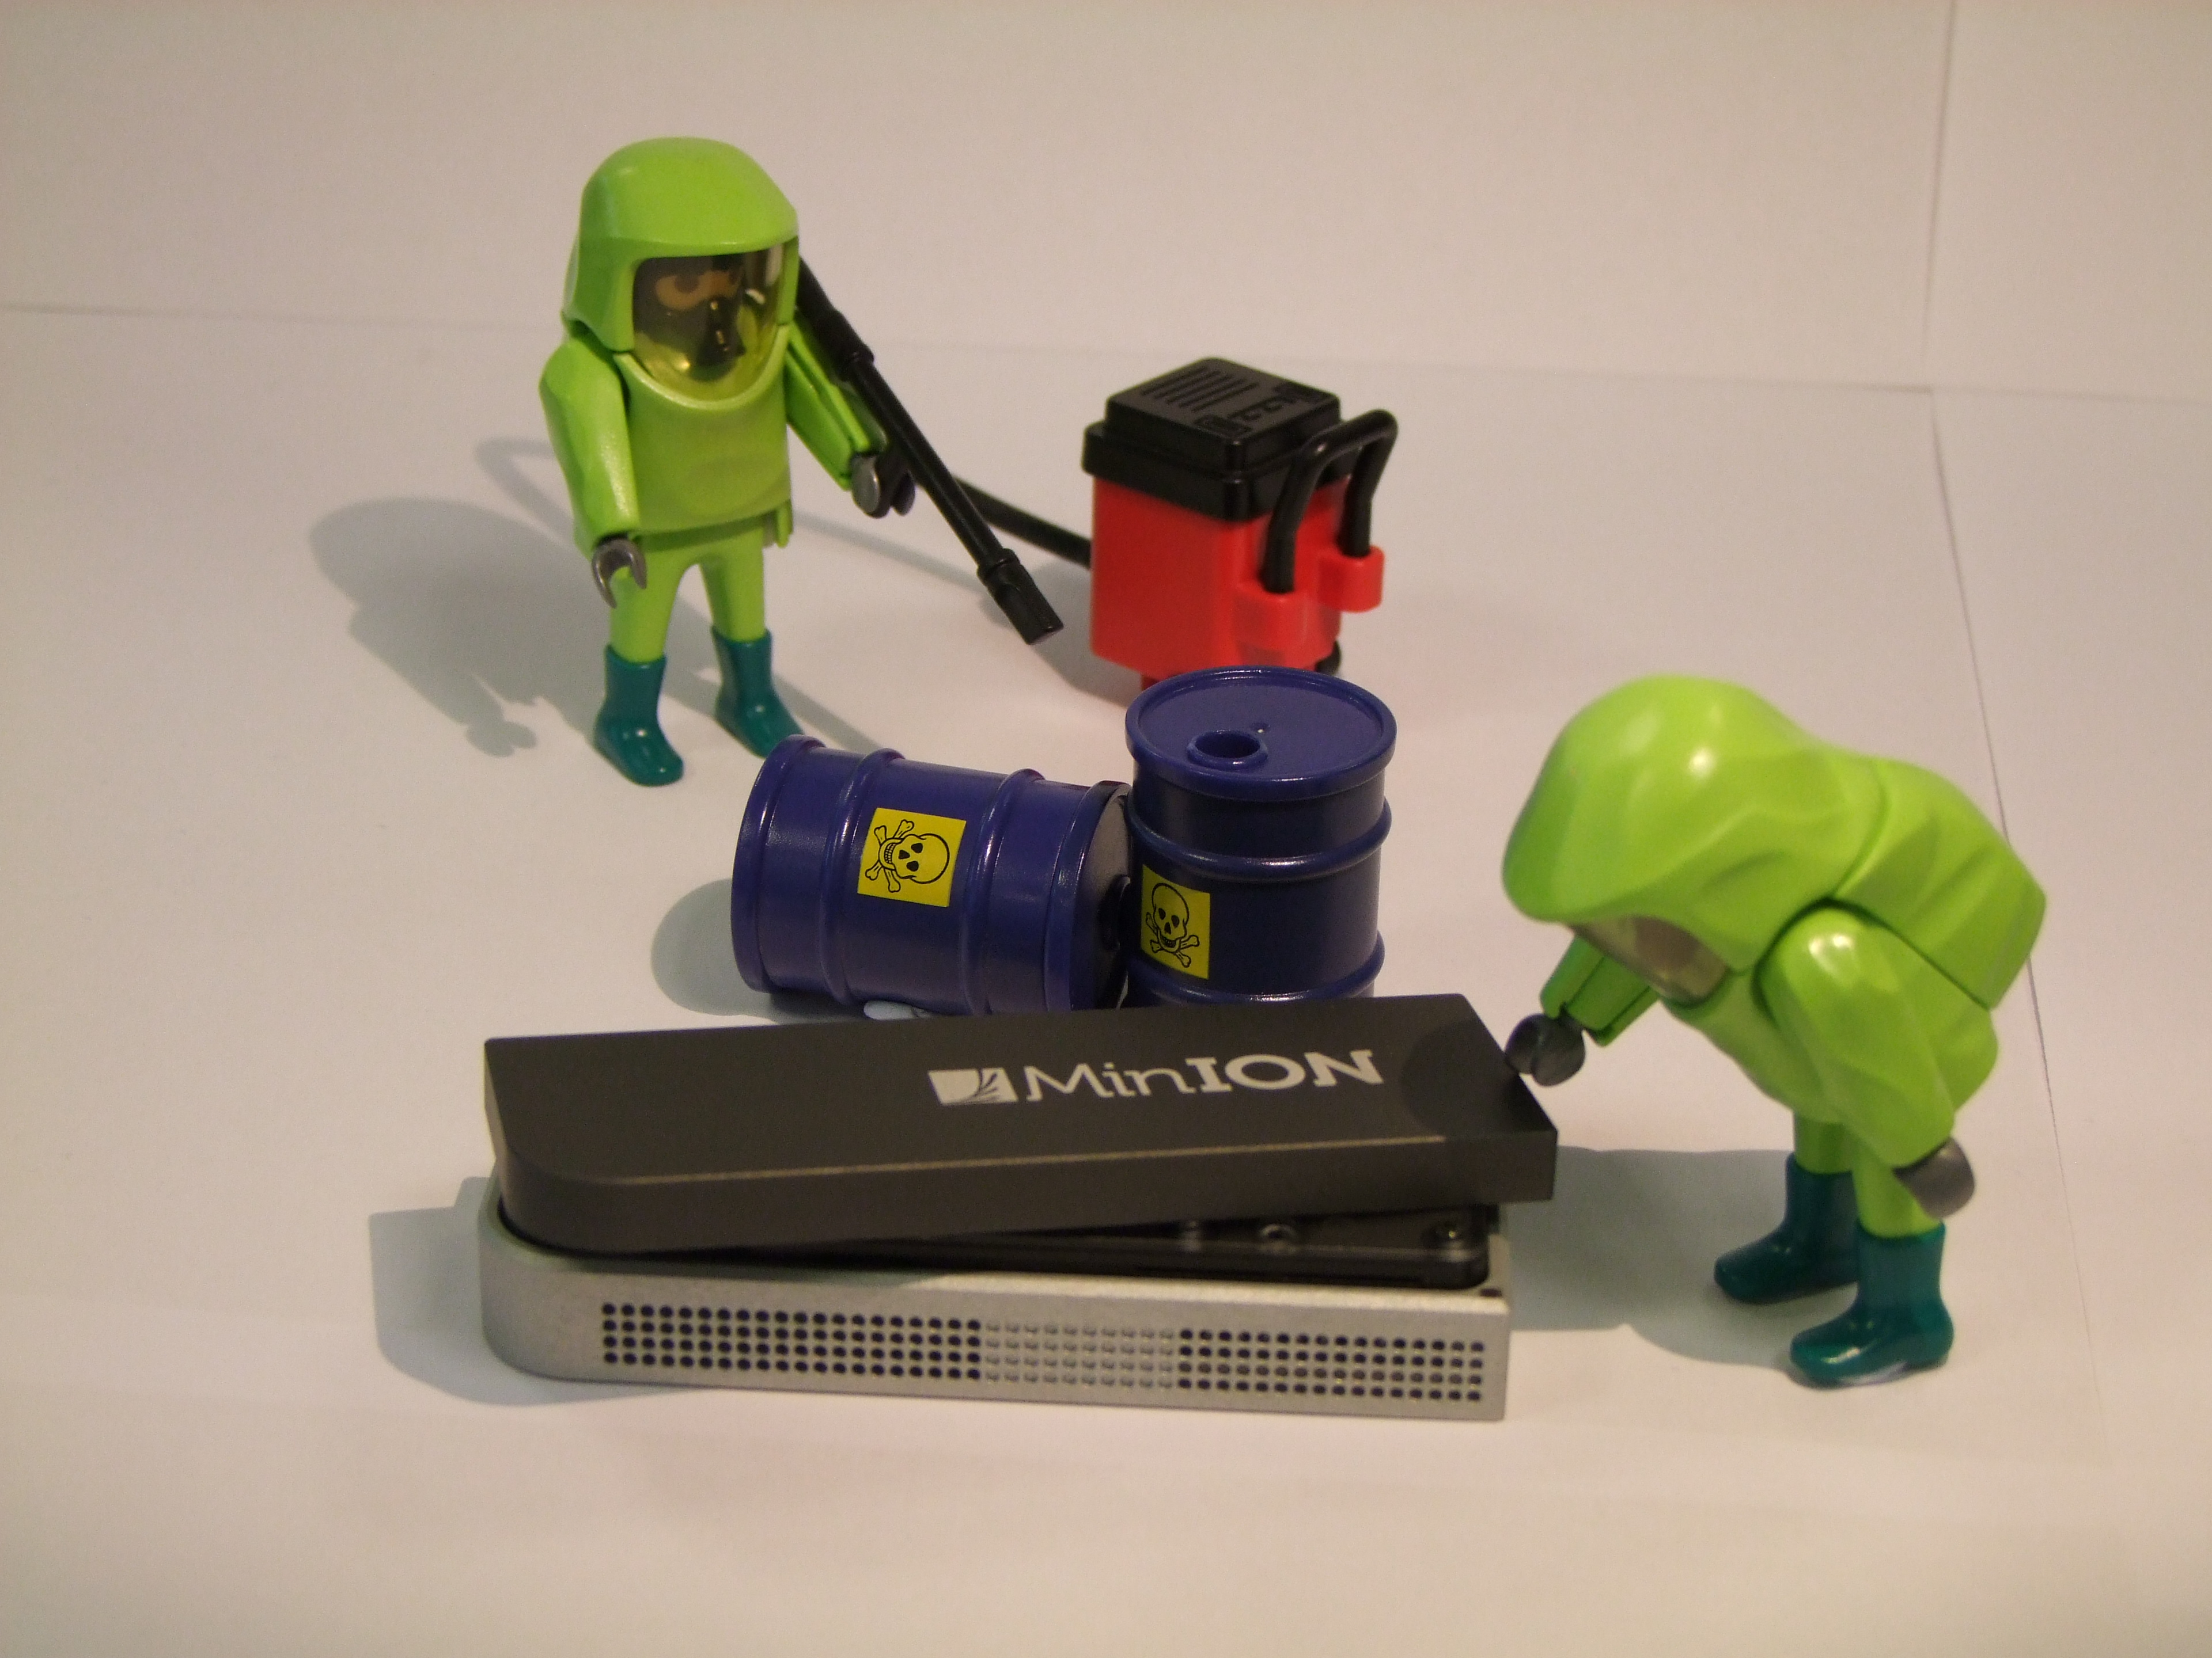
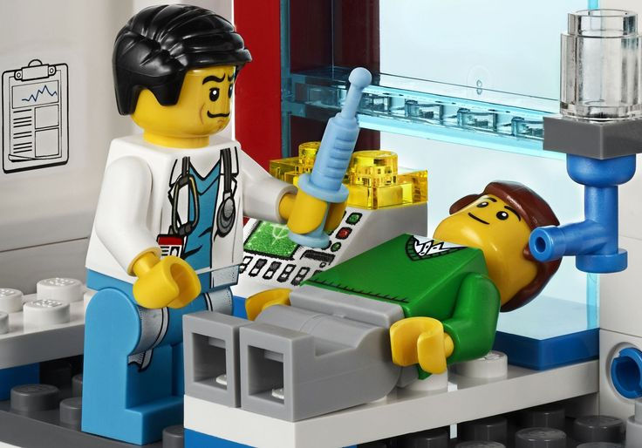


Slide 12

Towards a man-worn bio-detector

Slide 13
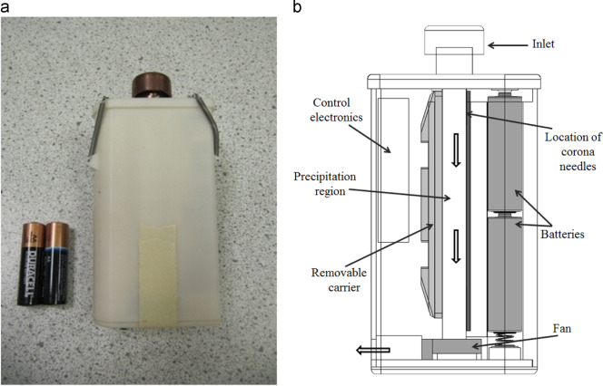
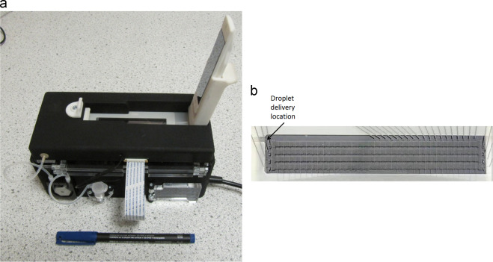
Towards a man-worn bio-detector

Slide 14
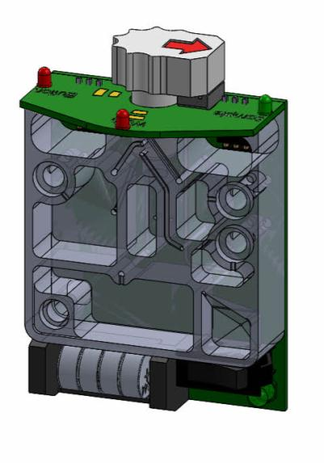
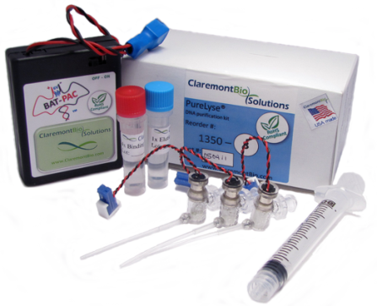
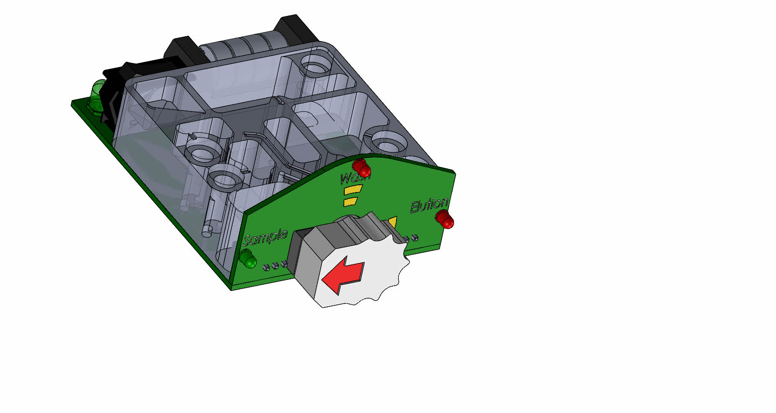
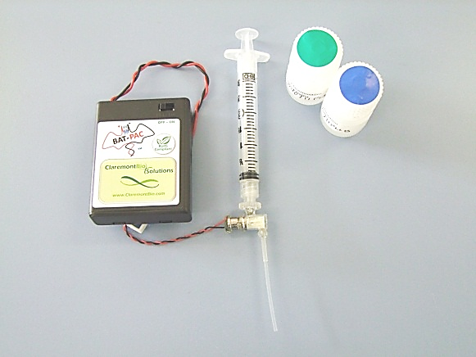


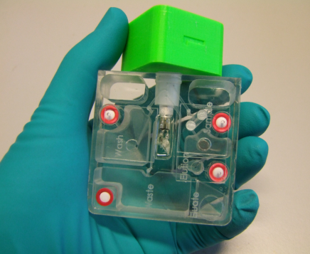
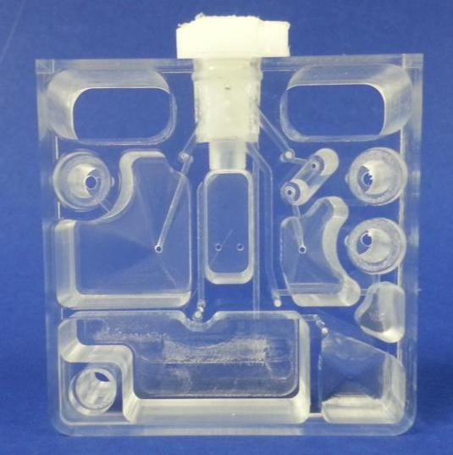
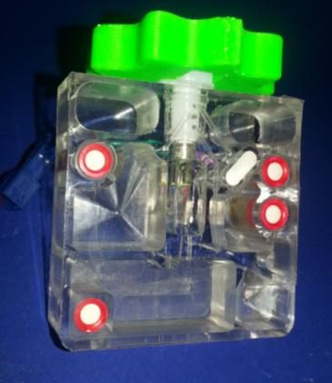
Rapid DNA extraction
CAD concepts
3D printed/machined prototypes
Functional prototype

Slide 15
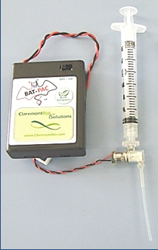
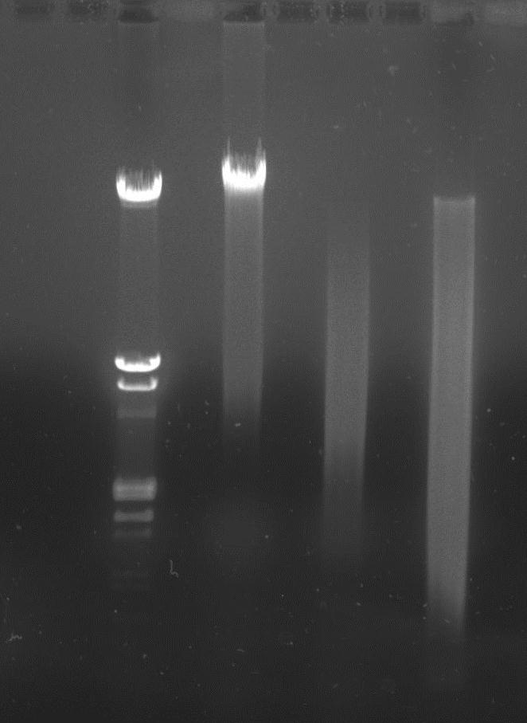
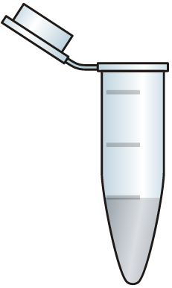
Rapid DNA extraction
M Reg Rap Rap
21
Column cleanup
5
2
Cultured bacteria, binding buffer + RNase,
2 minutes
Wash, 30 sec
Elute, 1 min

Slide 16
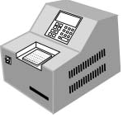
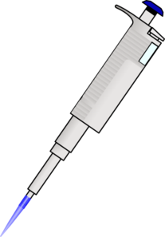
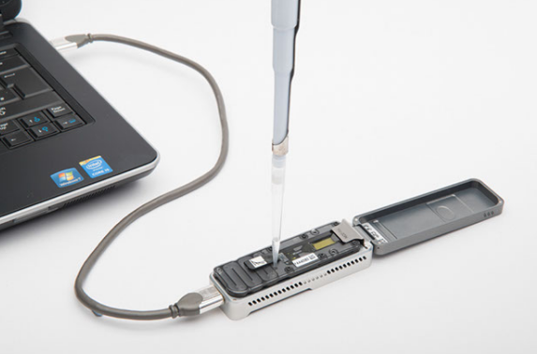
Rapid library prep
< 10 minutes

Slide 17
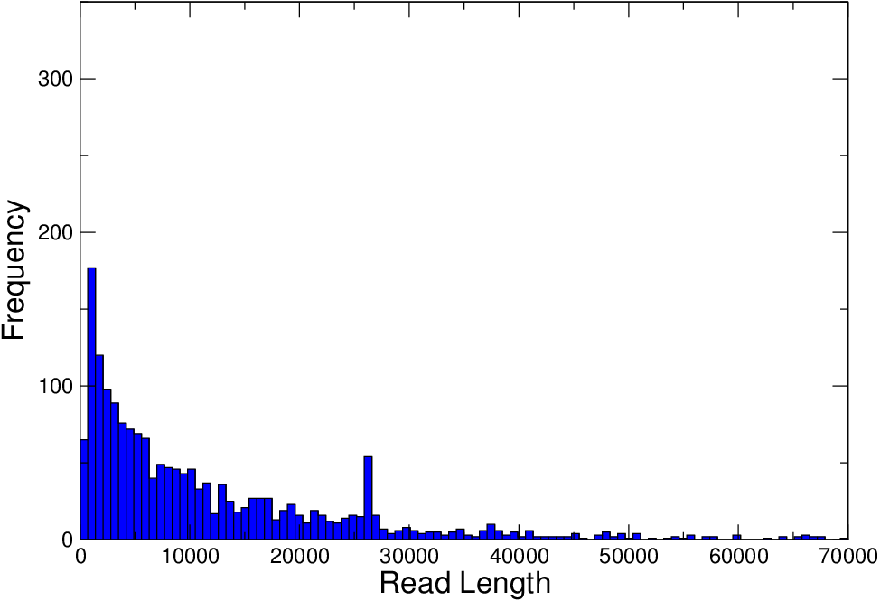
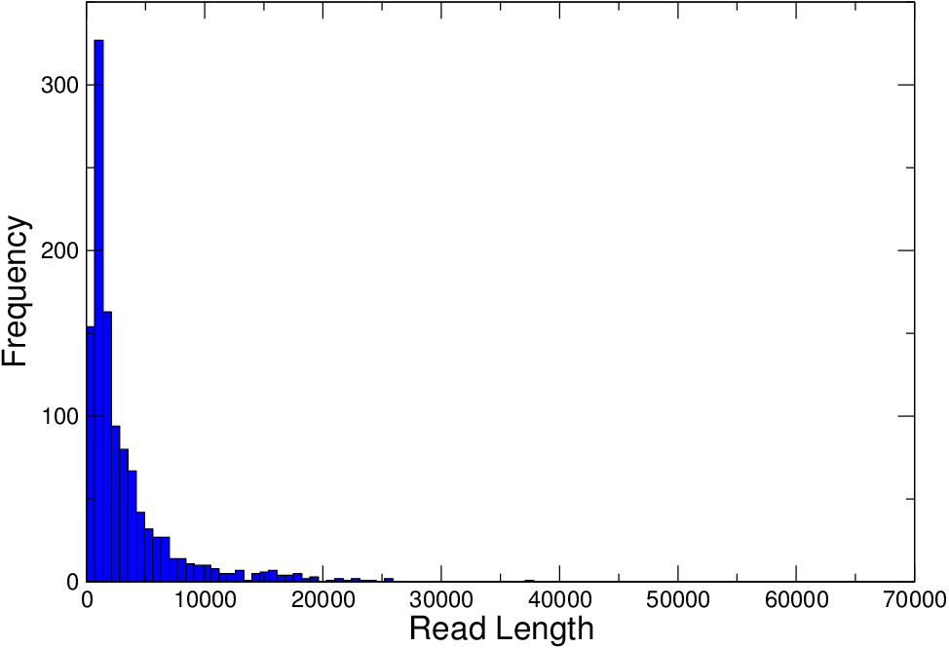
Rapid extract + rapid library + rapid sequencing
Standard extraction
Rapid extraction

Slide 18
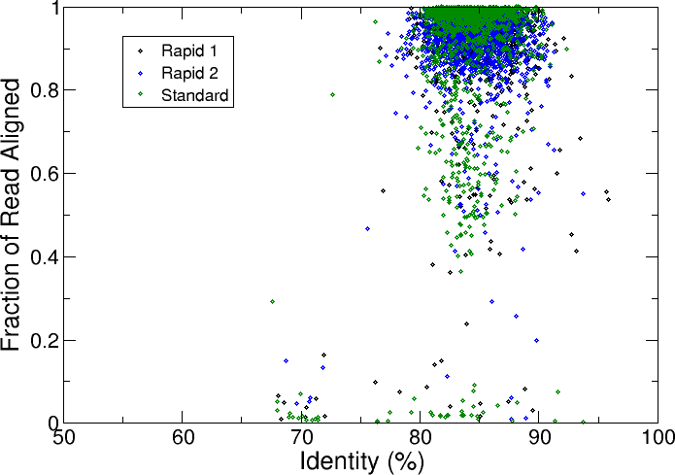
(Aligned to reference using LAST)

Slide 19
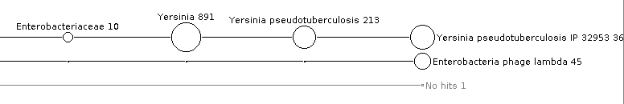
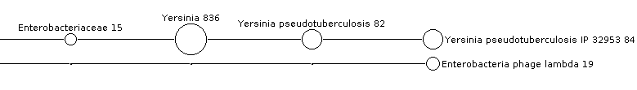
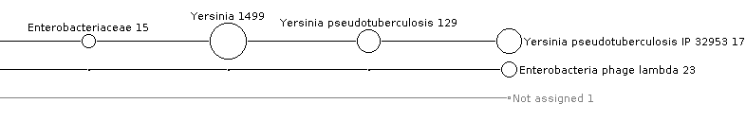
Identification – BLAST + MEGAN
Standard DNA prep/rapid library
Rapid DNA prep/rapid library
Rapid DNA prep/rapid library

Slide 20
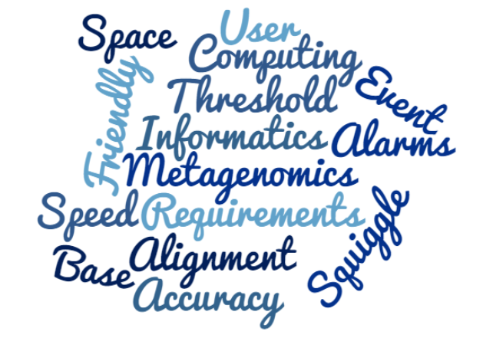
Informatics on the go…

Slide 21
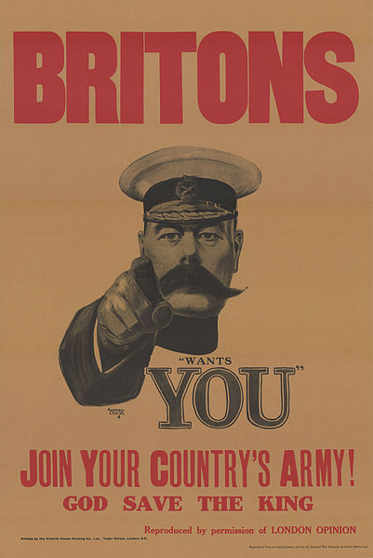
Acknowledgements
*
Tom Piggot
Phil Rachwal
Jamie Taylor
Carl Mayers
Pete White
Tim Foat
Dominique Despeyroux
Contact:
cllonsdale@dstl.gov.uk
Or use the app
* Being a Briton is not a pre-requisite for working with Dstl!

